Slide 1


ZippyPark
Problem & Solution
c
Product Overview
An optimized automated parking garage.
c
Demo 2 Additions
Team 2: Samantha Moy, Atmika Ponnusamy, Samantha Cheng, Kylie Chow, Andrew Ko, Parth Patel, Shreya Patel, Nandita Shenoy, Piotr Zakrevski

Slide 2
Problem & Solution
Problem
Standard parking garages are…
Inefficient
Cost ineffective
Impersonal
Difficult to manage
Solution
ZippyPark parking garages provide customers & owners with...
Reservation & walk-in system
Adjustable pricing scheme
Point reward system
Managerial hub
c
Product Overview
c
Demo 2 Additions

Slide 3
Product Overview
Problem & Solution
Customer Mobile App
Garage Sensors
Manager Website
Product Overview
UC 1, 2, 3 - Create, Edit, Delete Account.
UC 4, 5, 6 - Create, Edit, Cancel Reservation.
UC 7 - Enter Garage.
UC 8 - Exit Garage.
UC 9 - Update Spot Status.
UC 1, 2, 3 - Create, Edit, Delete Account.
UC 4, 5, 6 - Create, Edit, Cancel Reservation.
UC 10 - Display Statistics.
UC 11 - Points Management.
UC 12 - Payment.
UC 11 - Points Management.
UC 12 - Payment.
UC 11 - Points Management.
UC 12 - Payment.
c
Demo 2 Additions
ZIPPYPARK - DEMO 2
1 shared MySQL database ・ 3 subsystems ・ 12 use cases

Slide 4
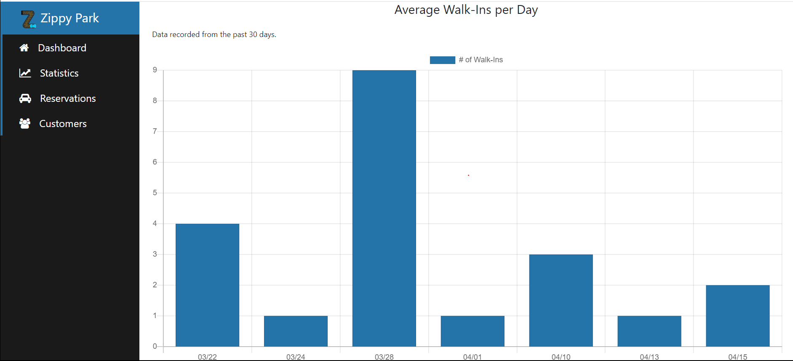
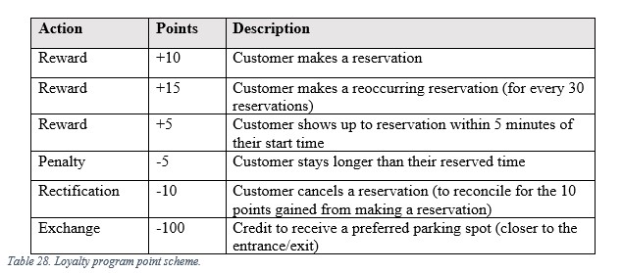
New Additions
Problem & Solution
Use Cases
UC-10: Display Statistics
Help make business decisions
Tracks parking garage usage
Leverages parking garage data to create graphs on website
UC-11: Points Management
Loyalty program
Points exchanged for VIP parking
Managers set points scheme
Product
Overview
Demo 2 Additions

Slide 5
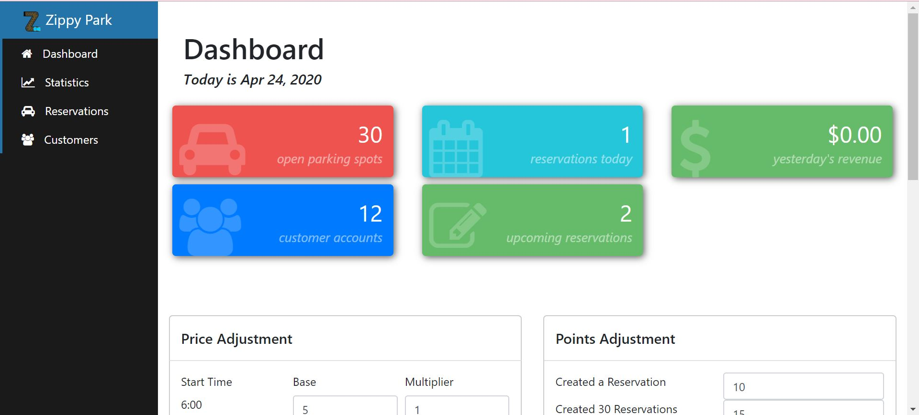
New Additions (cont.)
Problem & Solution
Use Cases (cont.)
UC-12: Payment
Payment = Base Fee * (# of time intervals) * Hourly Multiplier
Price calculation/notification:
In-app after reservation made
On scanner after walk-in exits (or reservation overstays)
Manager may set pricing scheme (manually or suggested by the data)
Product
Overview
Additional Features
Automatic price suggestion tool for managers
Manager dashboard cards
App pop-ups
Log-out ability
Demo 2 Additions

